Slide 1
Olist E-commerce Sales Analysis
A Strategic Dashboard Analysis Using Python and Power BI
- Presented by Shivam Kasaudhan

Slide 2

Project Overview
Objective:
To analyze sales, customer behavior, payment patterns, product performance, and seller efficiency in Olist's e-commerce platform using real-world data.
Tools Used:
Power BI
DAX
Python(Data Cleaning)

Slide 3
Problem Statement
The Brazilian e-commerce giant “Olist” wants to understand:
Which product categories are performing best?
How delivery time impacts customer satisfaction?
Who are the top-performing sellers?
What are the most preferred payment methods?
How customer distribution varies by region?
What are the top rated products.

Slide 4
Dataset Information
This is a Brazalian E-commerce dataet of orders made at olist store.
The dataset has information of 100k orders from 2016 to 2018 made at multiple marketplaces in Brazil.
This dataset consist of 8 tables.
The link to the dataset is :-
https://www.kaggle.com/datasets/olistbr/brazilian-ecommerce

Slide 5
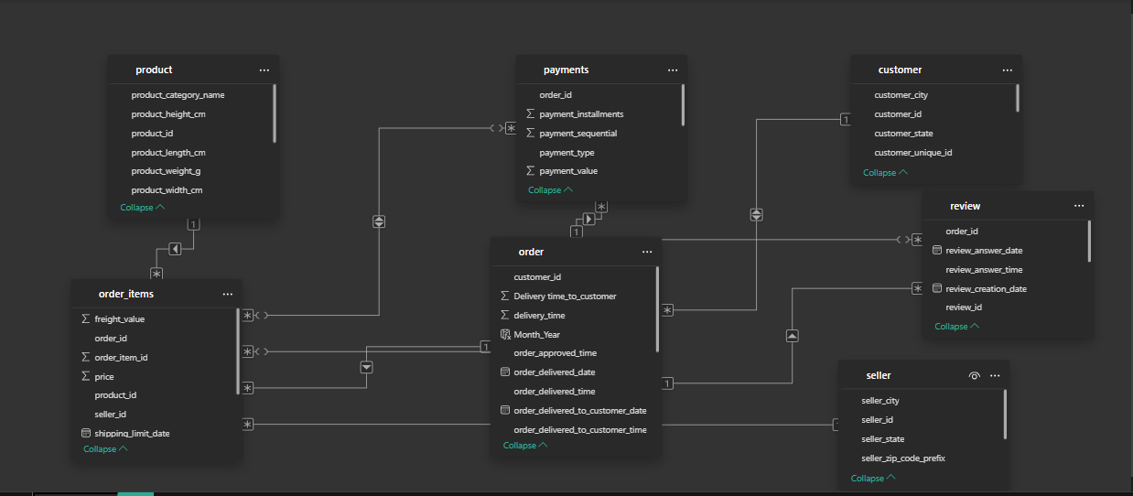
Data Modeling

Slide 6
Executive Summary (KPIs)
Key Metrics:
Total Revenue: R$ 16.01M
Total Orders: 95.6K
Total Customers: 96K
Total Sellers: 3095
Average Review Score: 4.09
Average Delivery Time: 13 Days

Slide 7
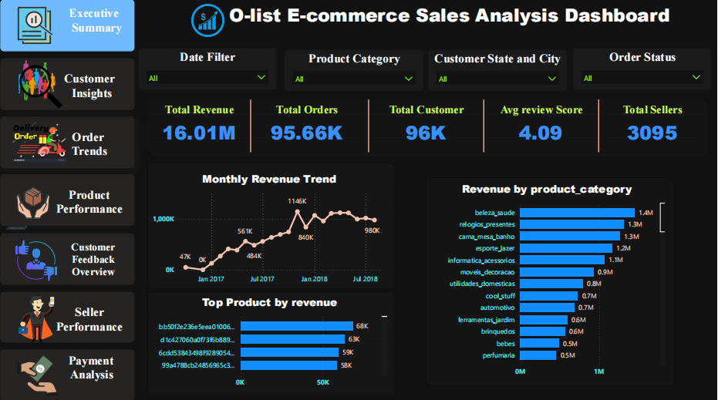

Slide 8
Customer Insights
KPI’s
Total Customer: 96K
Avg value per customer : 166.59
Avg order per customer : 1
Summary
SP(Sao Paulo) state alone contributes 41.6% of total customer and 35.7% of total sales.
Only 7.3% of cities account for 50% of customer count.

Slide 9
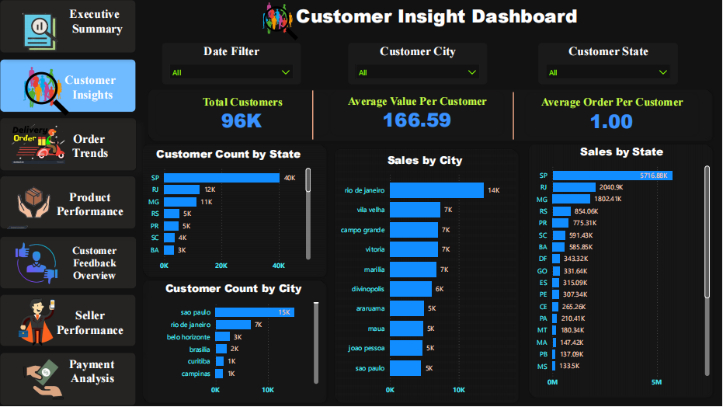

Slide 10
Order Analysis
KPI’s
Total Orders: 95.66K
Avg order value: 166.59
Avg order per day : 134
Avg delivery time: 13 day
Summary
Peaks are higher around November 2017 to March 2018.
These time period contributes to 34.2% of order.
99.99% of orders are delivered.

Slide 11
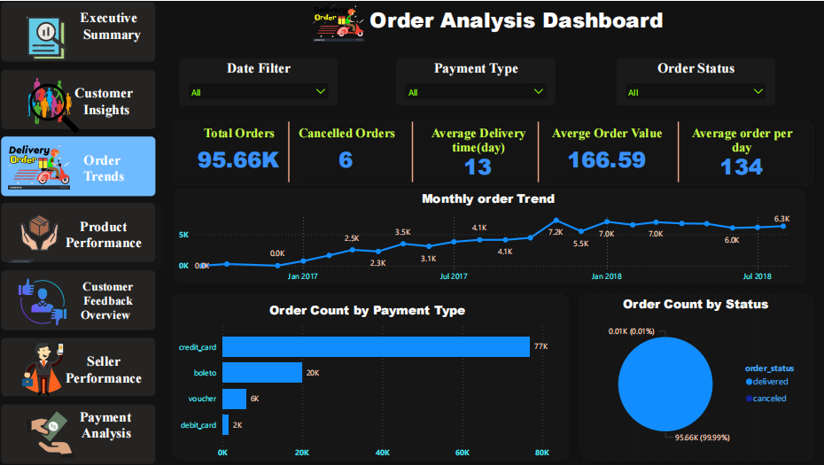

Slide 12
Product Performance
KPI’s
Total Products: 32K
Total product category: 73
Avg revenue per product : 495
Top product category : beleza_saude
Summary
The top 5 product categories (beleza_saude, religious_presentes, cama_mesa_banho, esporte_lazer, informatica assorios) alone contributes to 39.36% of total revenue
Top 5 categories contribute ~53% of total orders placed

Slide 13
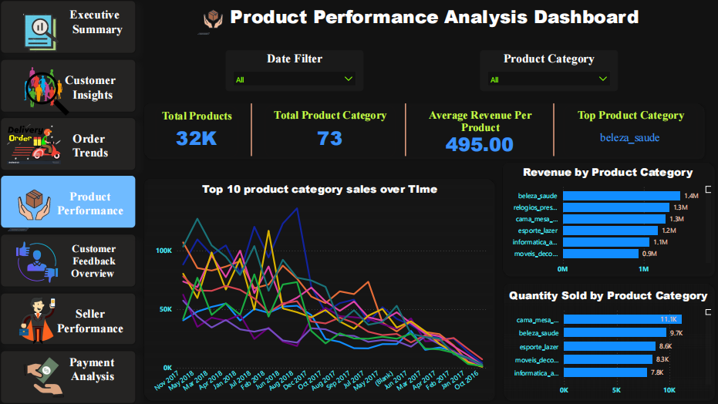

Slide 14
Customer Feedback
KPI’s
Total Reviews: 98K
Avg Review Score: 4.09
5- Star Review(%) : 58.25 %
1 or 2 star Review(%) : 14.81 %
Summary
Over 58% of all reviews are 5-star, resulting in a high average score of 4.09, showing strong customer satisfaction.
Top-rated categories include CDs/DVDs, Children’s Apparel, and Books, each scoring above 4.4 stars on average.

Slide 15
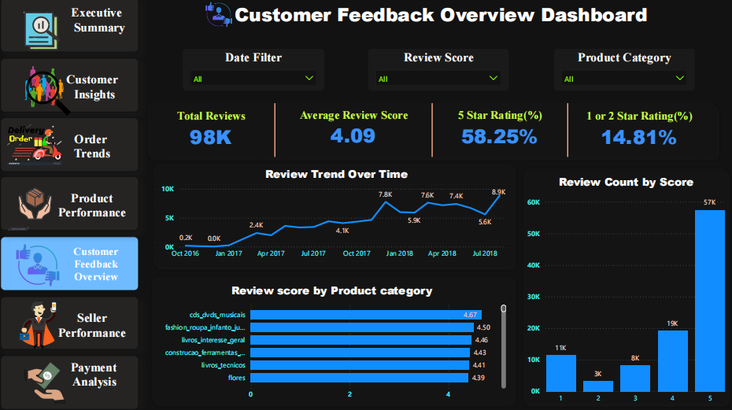

Slide 16
Seller Performance
KPI’s
Total Sellers: 3095
Avg Revenue per Seller: 5.17 K
Avg Delivery time per Seller : 3
Top Seller Revenue : 253 K
Summary
State Sao - Pulao(SP) alone contributes to 63.97% of total revenue of Seller.
State Sao - Pulao has more number of Seller as compare to other states.

Slide 17
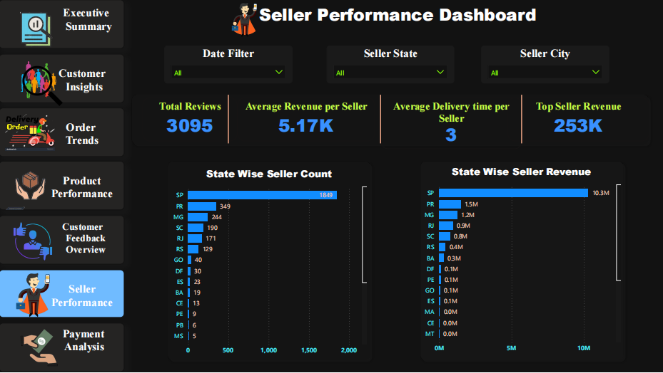

Slide 18
Payment Analysis
KPI
Total payment value :- 16.01 M
Average payment per order :- 167.34
Most common payment type :- Credit card
Order with installments :- 51K
Summary
Credit cards account for nearly 74% of all transactions, followed by boleto (19%) and voucher (5.5%), highlighting strong card payment preference.
Payment volumes peaked between Oct 2017 and mid-2018, with installment counts rising up to 20 payments per order in some cases.

Slide 19
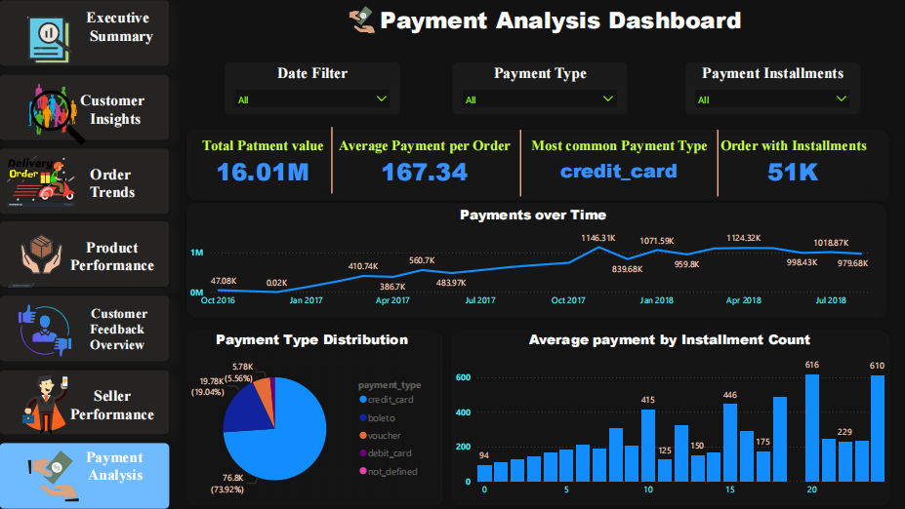

Slide 20
Dashboard Link :-
https://app.powerbi.com/view?r=eyJrIjoiNmUyOWVkYzUtOWIwYy00MjQ2LTg2ZDItZDI2ZjllYjcxNzU5IiwidCI6ImQ5OTRjYjA2LTljOTYtNGUxMC05YTQ2LTg4ZGM1OTEyNjc0ZCIsImMiOjZ9
Full project Link on github:-
https://github.com/analyst-shivam9455/Olist-E-commerce-Sales- analysis/tree/main
--- Thank You

